Slide 1
EE746 Neuromorphic Engineering Lecture 4a: Network of Neurons
Udayan Ganguly
udayan@ee.iitb.ac.in
Oct, 26, 2023
Computational Neuroscience book Ch 4 Neurons in a Network
You can also read https://neuronaldymics.epfl.ch/online/Pt3.html Chapter on population models
Also review the papers in case –studies; https://doi.org/10.1162/089976605342939
https://arxiv.org/ftp/arxiv/papers/1612/1612.02233.pdf
https://doi.org/10.1109/IJCNN.2015.72806467

Slide 2
Overview
IF vs. LIF neuron: A coincidence detector
How accurate is spike timing?
Modeling of average behavior

Slide 3
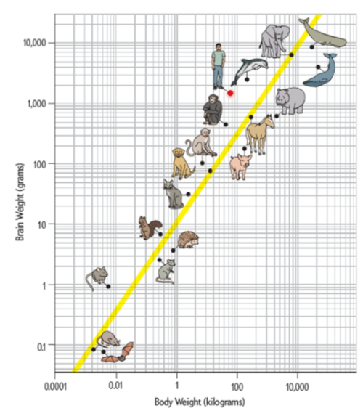
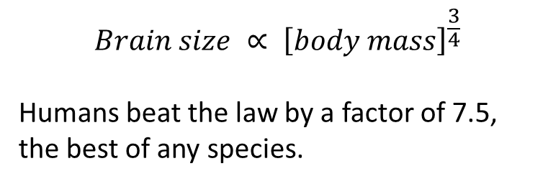
Number of Neurons/Bodyweight

Slide 4
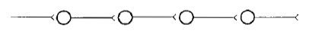

Neural Network
Sequential chain
Fully connected between layers
Layers
Input layer
Hidden Layer 1
Hidden Layer 2
…
Output Layer
Can you see diverging and converging chains?
Many types of connection
does not interact directly with external world)

Slide 5
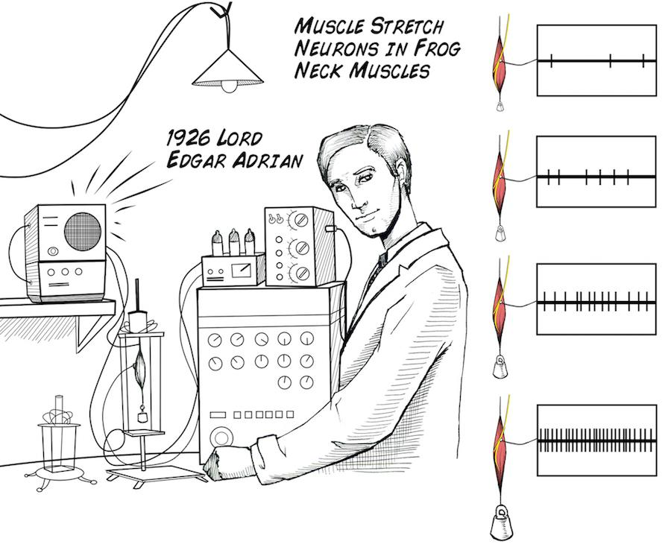

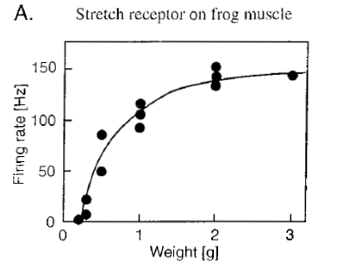
Neuronal Spiking Rate
https://backyardbrains.com/experiments/img/AdrianwithColorStretch_web.jpg
Edgar Douglas Adrian 1920.Nobel 1932
Listening to neurons by hooking them up to a speaker is like listening to Morse mode: Both signal and gap timing matters!!
Instantaneous Spiking Rate: Average rate of spiking around few spikes
Rate Coding: Encoding information in rates
Receptive field: Input which modulated neuronal spiking rate
What is the receptive field for muscle neuron?

Slide 6
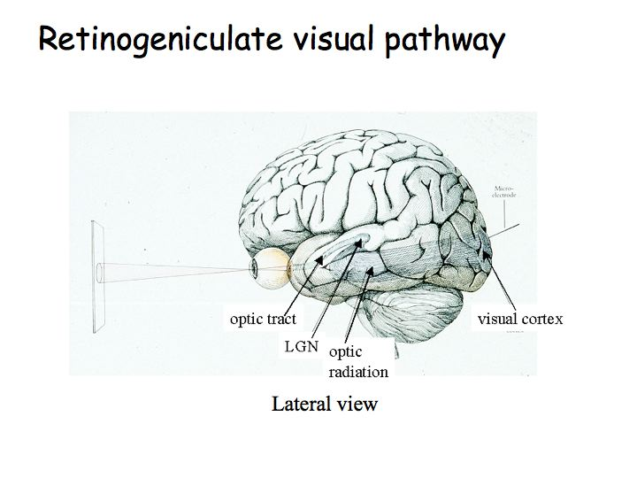
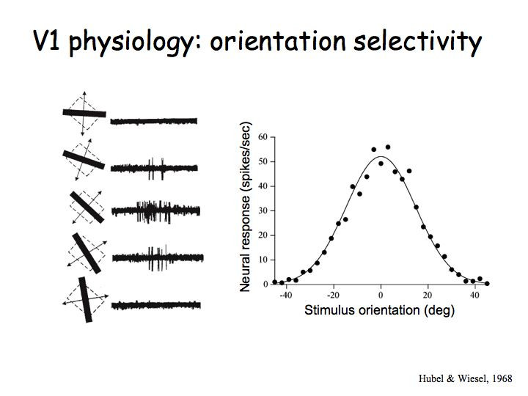
Visual Cortex Rate Coding
http://www.cns.nyu.edu/~dravid/courses/perception/lecturenotes/V1/lgn-V1.html
A Gaussian pdf with orientation is observed
What is the receptive field for visual cortex?

Slide 7
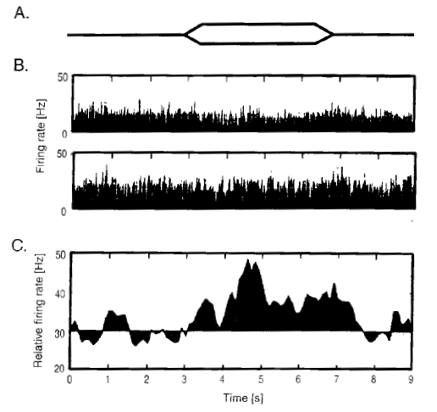
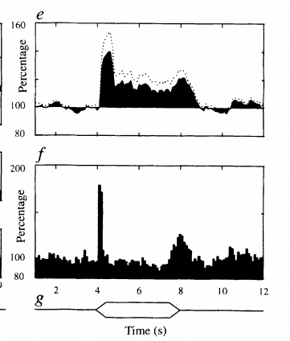
Auditory Coding (Same Rate; Phase Match - synchrony)
DeCharms and Merzenich, Nature 1996
Envelope of amplitude
Neurons at cortical location A
Coordinated Rate
Neurons at cortical location B
Rate change
Coordinated Firing Rate
Rate (t) is different for neuron at A vs B
Rate coding
Notes:
http://dx.doi.org/10.1038/381610a0
Cortical population coding could in principle rely on either the mean rate of neuronal action potentials, or the relative timing of action potentials, or both. When a single sensory stimulus drives many neurons to fire at elevated rates, the spikes of these neurons become tightly synchronized, which could be involved in 'binding' together individual firing-rate feature representations into a unified object percept. Here we demonstrate that the relative timing of cortical action potentials can signal stimulus features themselves, a function even more basic than feature grouping. Populations of neurons in the primary auditory cortex can coordinate the relative timing of their action potentials such that spikes occur closer together in time during continuous stimuli. In this way cortical neurons can signal stimuli even when their firing rates do not change. Population coding based on relative spike timing can systemically signal stimulus features, it is topographically mapped, and it follows the stimulus time course even where mean firing rate does not.

Slide 8
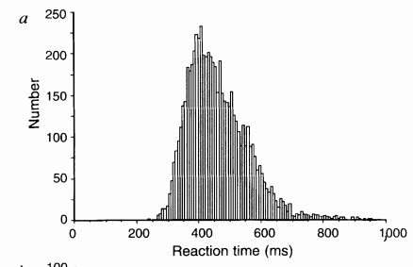
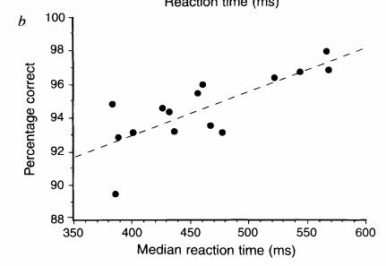
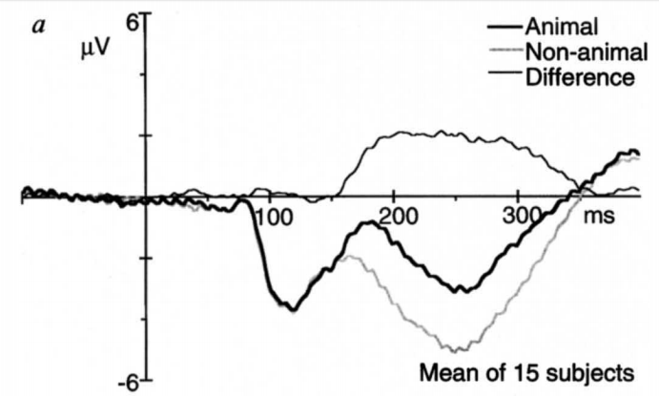
Evidence for rate vs. temporal code.
Thorpe Nature 1996
Animal/No animal is shown for 20ms with various distractions
Decision about an animal is made 150ms after stimulus
This is too fast for rate coding;
Decision is made using few spikes; Exact timing is info (not rate)
Event related potential
Temporal coding
Notes:
https://www.nature.com/articles/381520a0.pdf
7 males 8 females 1-2 second interval between images. Animals in natural settings vs. non-animals (house, lake, mountain); Release button upon detection; accuracy vs. time trade-off is observed; response is 400ms;
7 electrodes in frontal region to detect earliest differential response; All electrodes and 15 person data is averaged;
163 ms is the earliest onset of difference. Fast and slow responders test are same speed by electrode measurements.

Slide 9
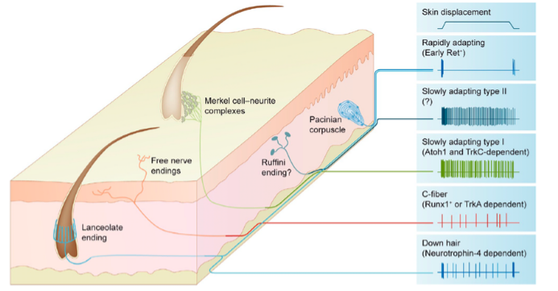
Various types of responses for same input of skin touch – diverse representation
What is the information coded by various neural responses?
amplitude vs. time
change / gradient vs. time
gradient sign?

Slide 10
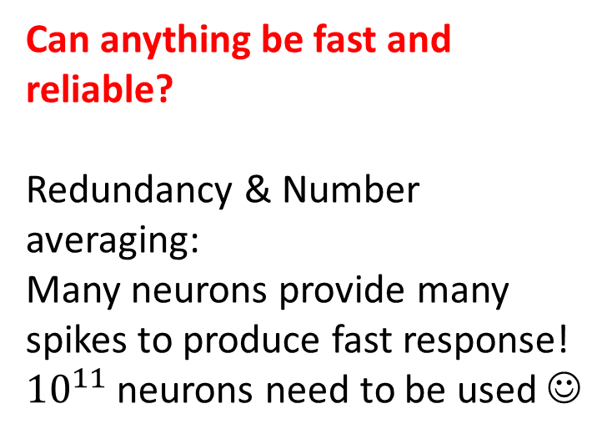
One possibility of resolution: Rate vs temporal
Rate code:
Strong unreliability
Takes long time to estimate rate
Temporal code
Noisy & reliable
Fast – consistent with experiments
Fast, unreliable
500ms to estimate rate
150ms
N1

Slide 11
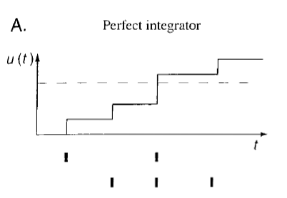
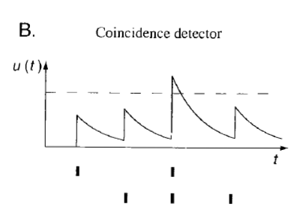
Neuron LIF : Coincidence Detector
Based on circuit characteristics draw an LIF membrane potential
Both neurons will reach threshold;
However, which one is more sensitive to coincidence?
LIF neuron ;
IF neuron only counts; does not forget in time; hence cannot track coincidence
Under what condition will LIF work as IF?
When L is low compared to spike rate
Will LIF also capture rate? What about IF?
Yes both will; but LIF is strongly affected by coincidence
Notes:
Matlab code for LIF vs IF
https://drive.google.com/open?id=1bnUSYe6sMHQYNPw3Cg4kCZnkwsiv22nB

Slide 12
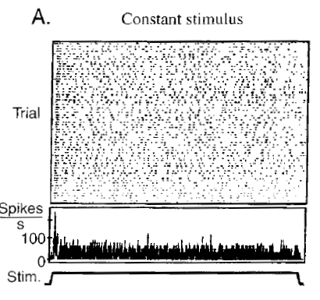
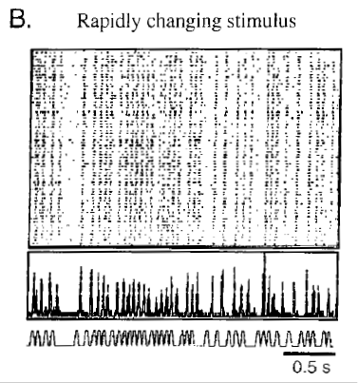
How accurate is spike timing?
Why is this observation random?
This data indicates the neurons like natural spiky signals – not unnatural DC value. If the fluctuating signal is repeated, the spiking pattern is repeated. Neurons are not noisy;
What is the biochemical origin of dislike for DC?
Because, neurons like spikes not DC signal; there is a timescale to each biochemical process;
Essentially, this data indicates “misleadingly” the neurons are noisy

Slide 13
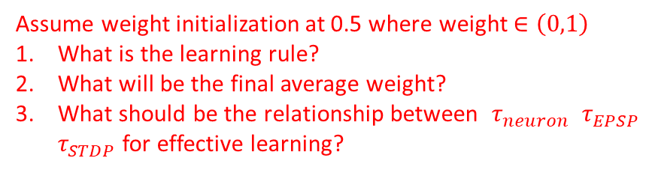
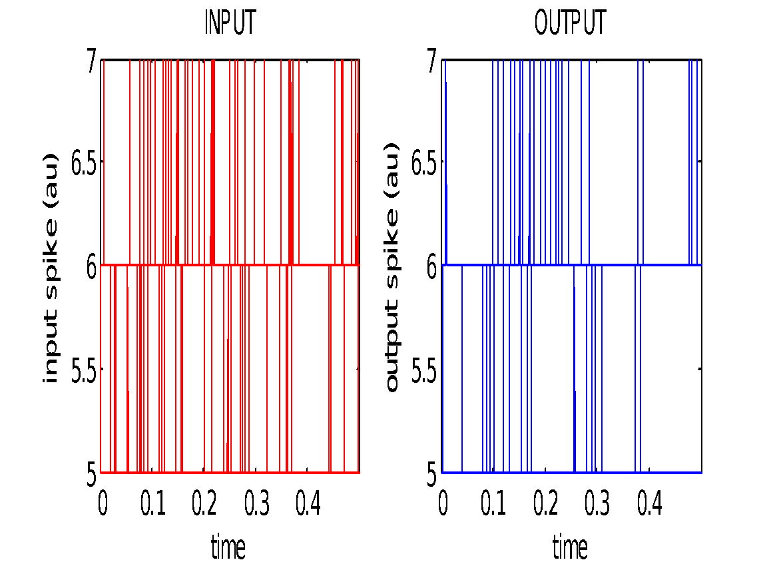




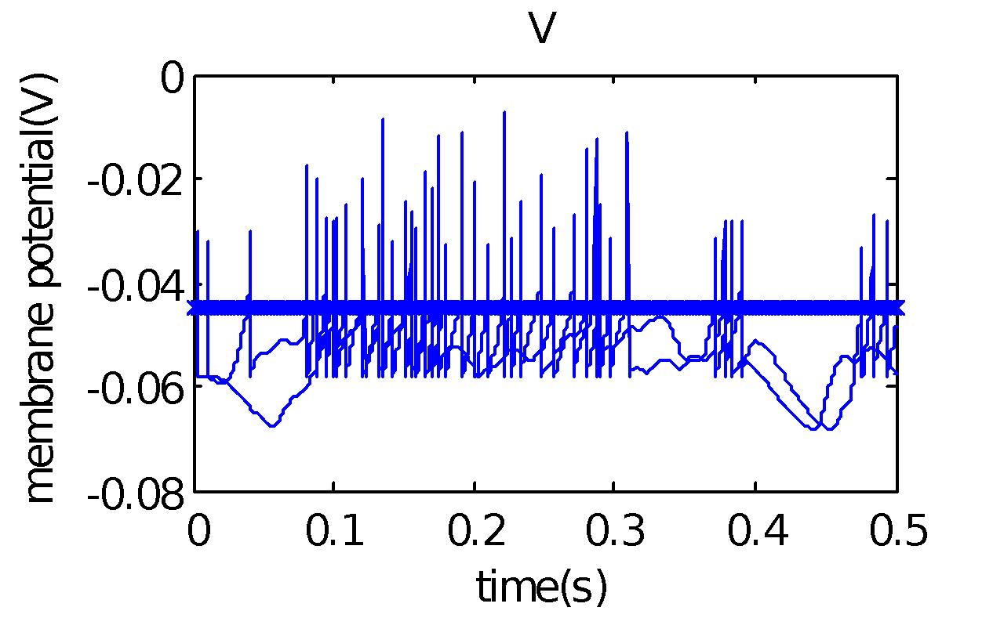
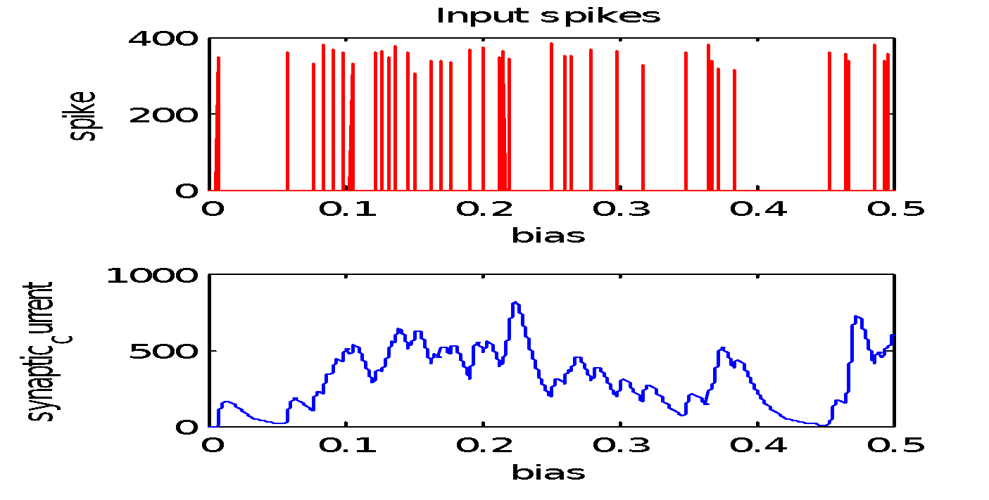
Simple SNN: Recognize
Objective 1: Use 100 pre to 1 post neuron network to discriminate any signal
Any signal? Lets choose two random Poisson signals for 100 neurons;
Each neuron may spike 1Hz
1
Post
Output 2
i
N
Output 1
Total input frequency?
Signal 2
EPSP
EPSC
Signal 1
Notes:
Code: neuron_code_h2p5

Slide 14

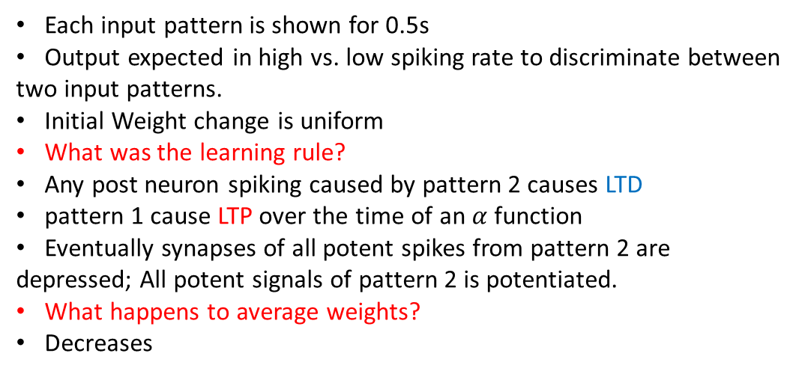


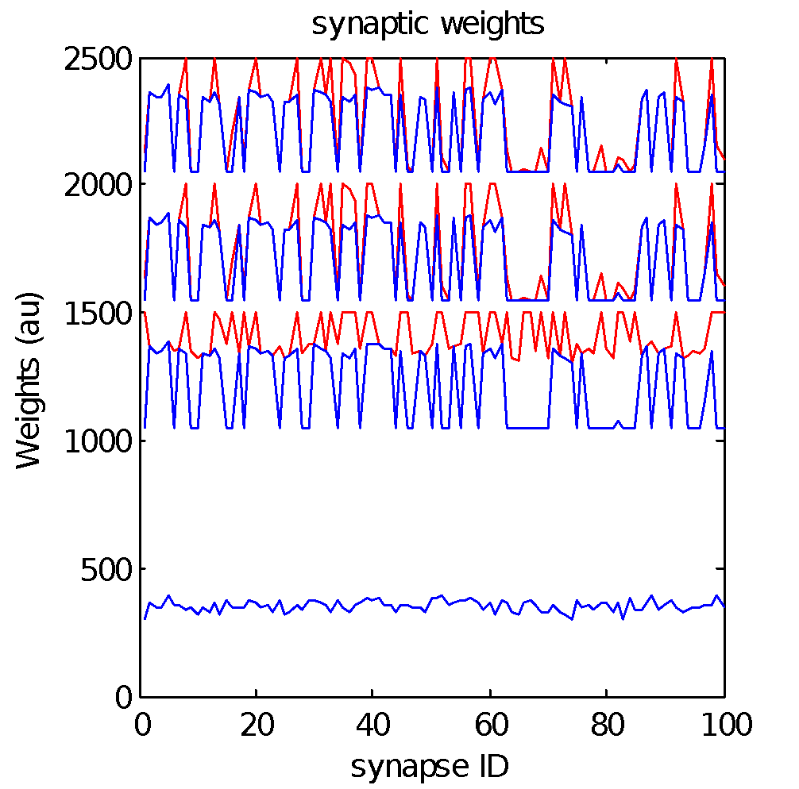
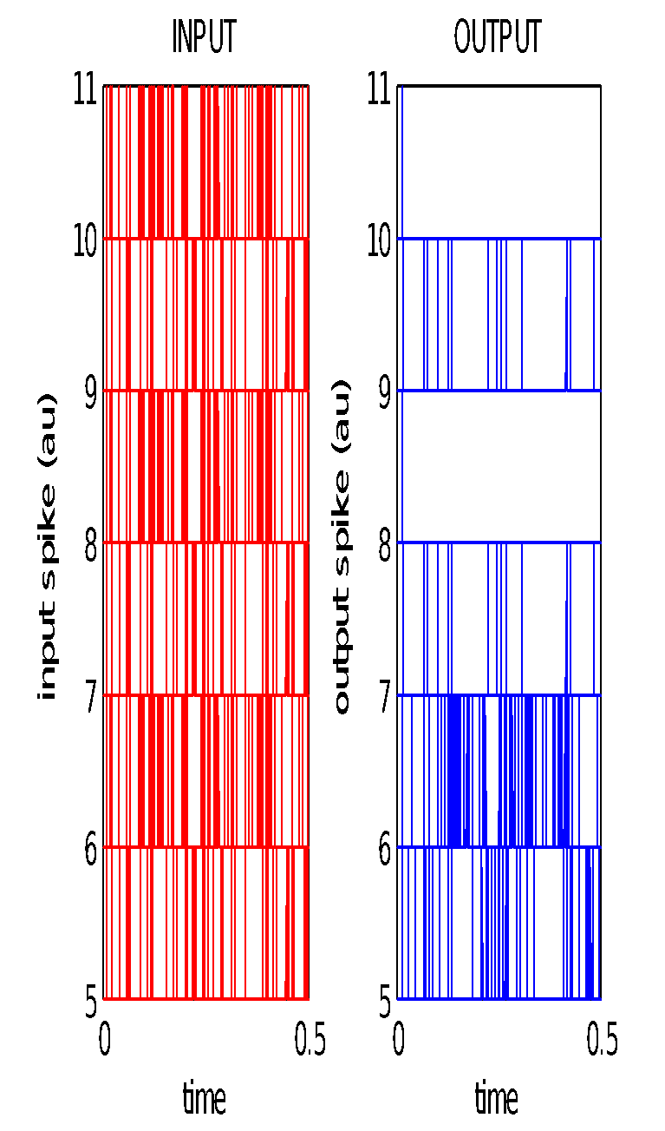

Simple SNN: Learning
1
Post
i
N

Slide 15
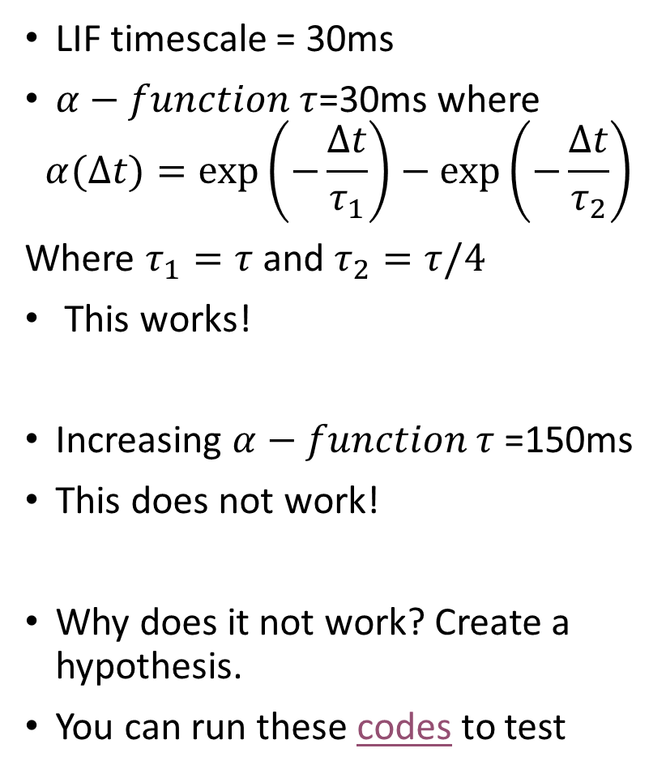
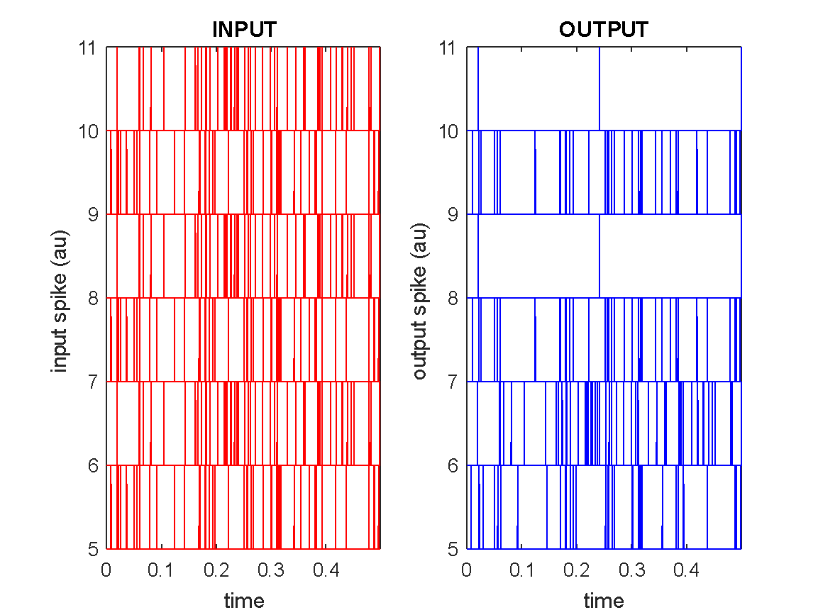
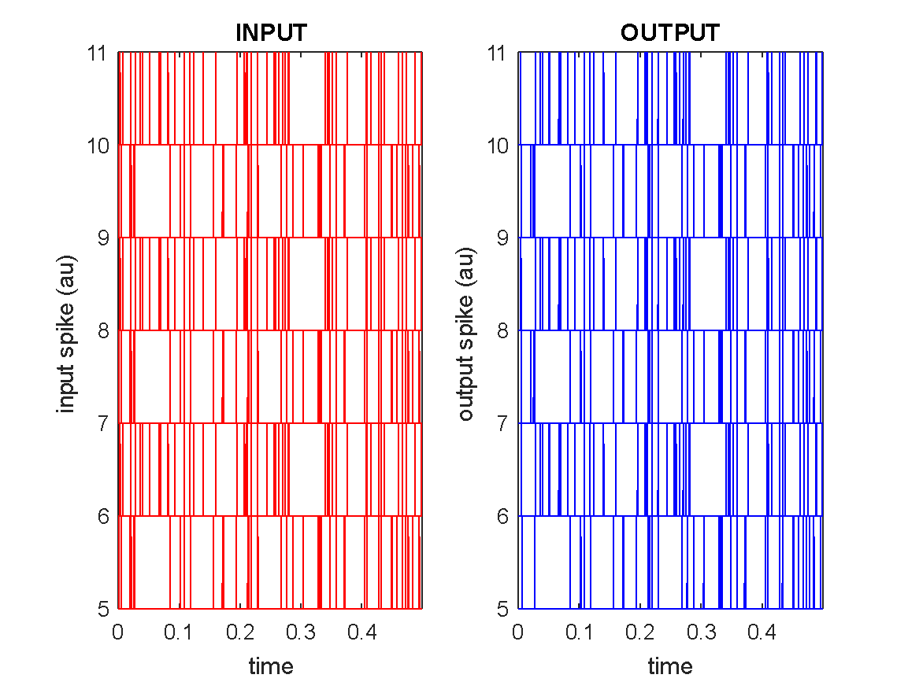
A debug

Slide 16
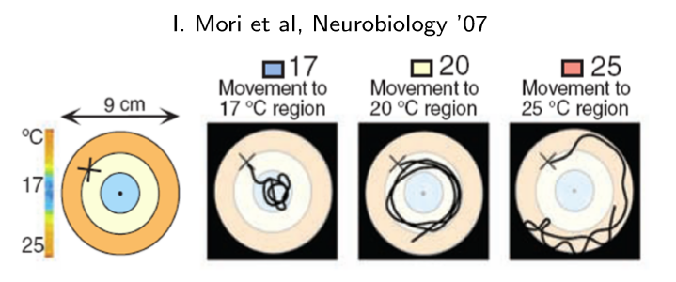
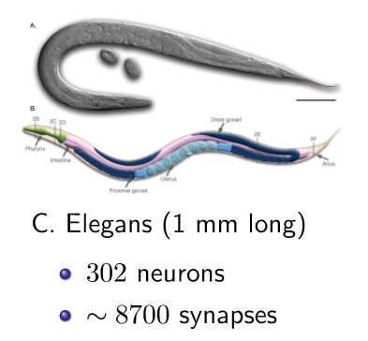
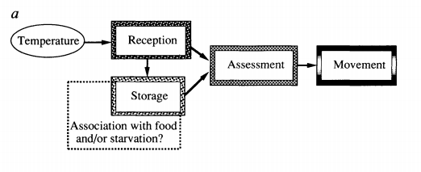
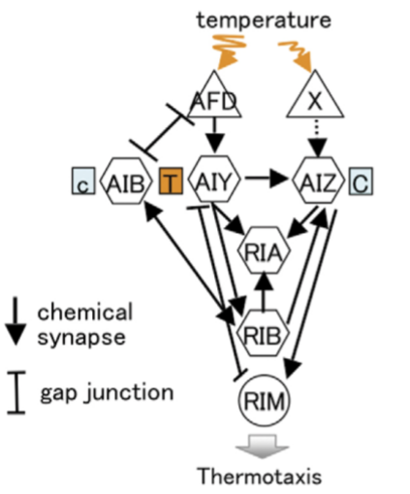
Navigation: Thermo-taxis
The C. Elegans finds the temperature of its birth
The C. Elegans performs the following tasks to related input (Temperature) to movement (thermotaxis)
C. Elegans is the hydrogen atom of neuroscience
Neurons can be zapped with lasers to disable them to isolate neural circuit for thermotaxis

Slide 17
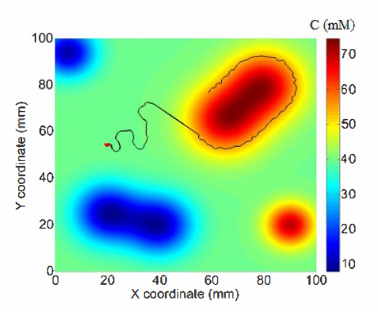
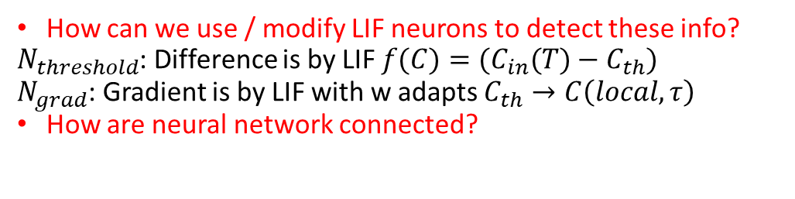
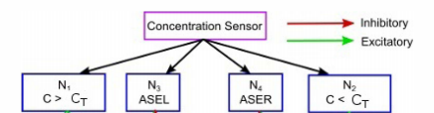
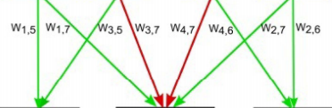
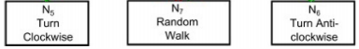
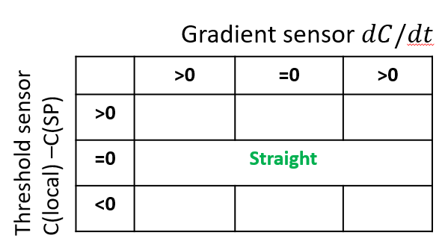
Design a Chemo-taxis Neural Circuit
S Santurkar IJCNN 2014 https://doi.org/10.1109/IJCNN.2015.7280646
How does worm find its way to “desired” chemical concentration? What in the information needed to decide?
Sign and magnitude of Difference with DC level
Gradients sign and magnitude
How are motion directions decided using above?
Explore (unbiased) vs. change (biased) direction choice
Why do we have both clockwise & anti-clockwise turn?
What happens if we do not have anti-clockwise turn?
Change | Random

Slide 18
Design a Chemo-taxis Neural Circuit
S Santurkar IJCNN 2014 https://doi.org/10.1109/IJCNN.2015.7280646
How does worm find its way to “desired” chemical concentration?
What in the information needed to decide?
Sign and magnitude of Difference with DC level
Gradients sign and magnitude
How are motion directions decided using above?
Explore (unbiased) vs. change (biased) direction choice
Inhibit Random walk to go systematically; random walk is unbiased searches to be tuned out towards highest gradient
Why do we have both clockwise & anti-clockwise turn?
Imagine moving along a hill trying to maintain a fixed height; One side will be high; another low; this choice helps oscillate along trajectory like a snake. (mimics biology!)
What happens if we do not have anti-clockwise turn?
Any unfavorable situation will cause worm to sample all direction serially
AND operations is produced with threshold (i.e. 2 pre-neuron inputs can activate); Easy to have separate directions 🡺 separate ANDs (down vs. up gradient);
Same direction using 4 inputs 🡺 needs design
 | >0 | =0 | <0
>0 | Change | Random | straight
=0 | Straight
<0 | straight | Random | Change

Slide 19
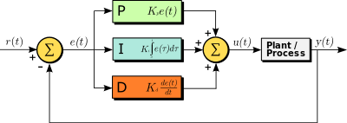
Parallel to a PID controller
https://en.wikipedia.org/wiki/PID_controller
P accounts for present values of the SP-PV error.
I accounts for past values of the SP-PV error and integrates them over time to produce the I term.
D accounts for possible future trends of the SP-PV error, based on its current rate of change.
What is the difference between the neural circuit and PID controller?
Neural circuit is a PD controller.
Why is integration not important?
Small errors/offsets are not critical
What is the equivalent of changing synaptic weights for a PID controller?
Tuning PID controller parameters; This is a difficult problem; <open problem>

Slide 20
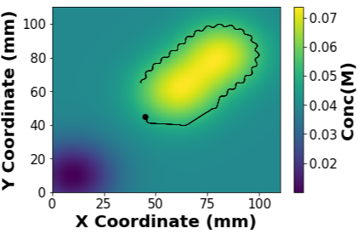
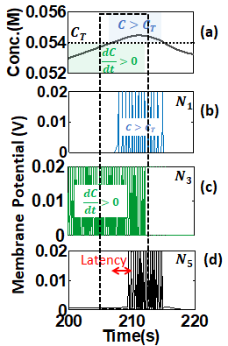
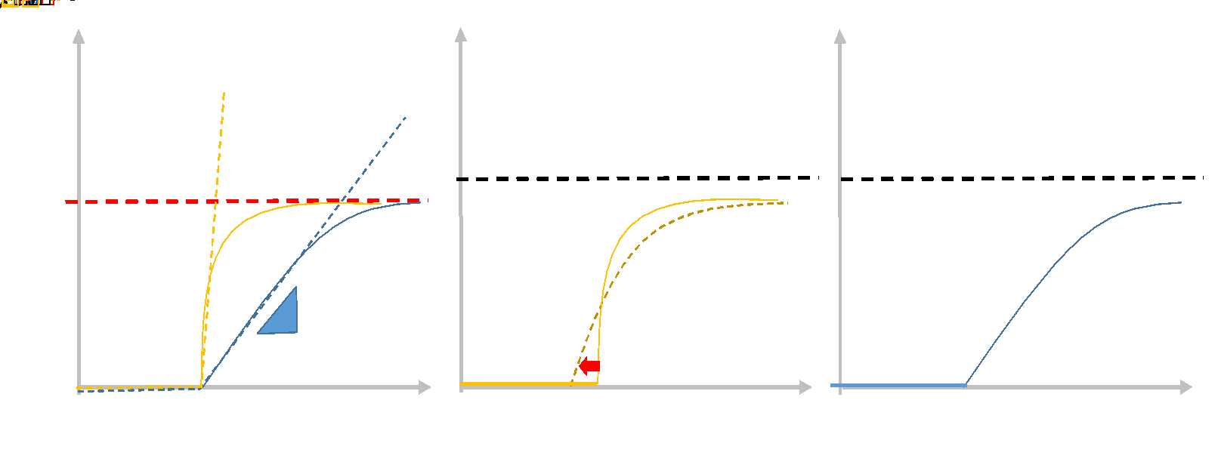
Can you engineer a neuronal AND gate?
S Shukla ICANN 2018
Input neurons senses concentration and concentration gradient
Temperature cause turning

Slide 21
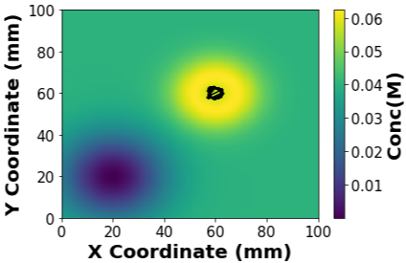
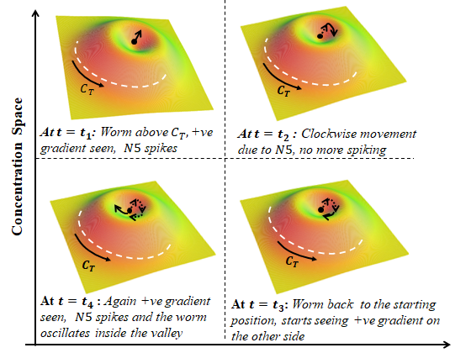
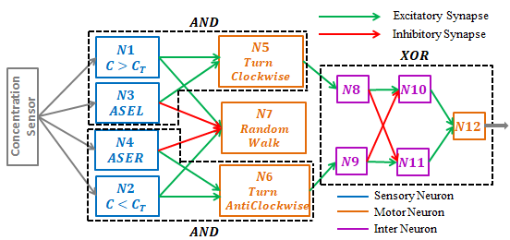
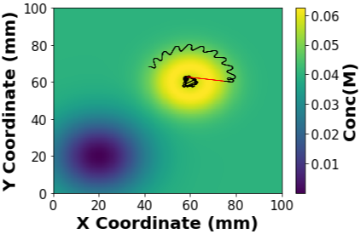

Other dynamics: Escaping local minima
https://drive.google.com/open?id=0B6Vw29Er5yFHMUJiU29ybmlIRzBjSWxBekxuQ1BJSXdSeXJr
Notes:
Here is the paper link
https://drive.google.com/open?id=0B6Vw29Er5yFHMUJiU29ybmlIRzBjSWxBekxuQ1BJSXdSeXJr

Slide 22
Structure of the progress
We studied a simple filter
We re-invented the existing design in class
Reverse engineering a C. Elegans Chemotaxis
Reviewed further questions which leads to open questions
Solutions of such questions will lead to research papers!

Slide 23

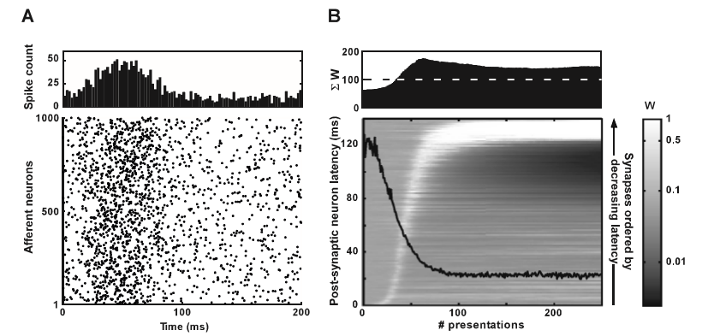
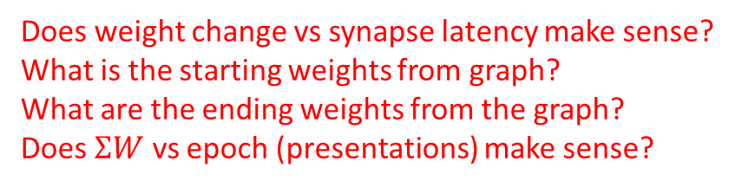
IF Neurons tune to the earliest spike by STDP
1
1
https://doi.org/10.1162/08997660534293
2
STDP: τ+ =−20ms and τ− =22m
What should happen?
What happened? Note down points
3
Output Layer (1)
Input Layer
(1000)
Spike Distribution
Some increase late but don’t decrease
spontaneous
signal
Some weights increase and decrease strongly
spike
Some weights increase early and decrease
In a 1000x1 array, a small Gaussian pattern is added;
Rest is spontaneous (5Hz)
Post neuron spikes start late (120ms) but moves towards the beginning of the signal (20ms)
Notes:
Flat in the beginning
Increases as the post spike moves early; As it saturates the increase is high

Slide 24
Weight Change and post neuron spike latency evolution
1
1
2
Output Layer (1)
Input Layer
(1000)
3
Pre spikes
Pre
Epoch 1
Post Spike
Pre
Epoch 2
Post
Some increase late but don’t decrease
Weight Before STDP
Some weights increase and decrease strongly
Weight after STDP
Epoch 1
Pre
Epoch 2
Epoch 2
Pre
Some weights increase early and decrease
Weight after STDP increases for causal pre-neurons and decreases for anticausal ones
Epoch 3
Post
Epoch n
If post neuron spike is left to evolve the post spike will advance forward
The post spike “swims” forward
Towards lower latency!
If post neuron spike is statics but repeated epochs; the weights would evolve!

Slide 25
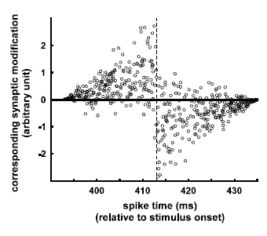
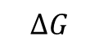



Further questions to establish generality
Assumptions
Post neuron is IF: It is a counter; Spikes only once;
STDP: Deterministic
Zero Jitter:
Spontaneous activity:
Convergence Criterion: Spiking latency is stable
Questions
Can neurons be LIF
This should enable coincidence detection i.e. temporal coding
Can STDP be stochastic like biology?
But why?
Biology has jitter
Biology has spontaneous activity
τ+ =−20ms and τ− =22ms

Slide 26


Adding Jitter or Spontaneous activity
These non-idealities post-pone convergence to low latency! But convergence will occur!
Come up with reasons for above two observation.
On the average spontaneous firing will cancel each other out with STDP;
On the average the weight change will be average for jitter; assuming low STDP rate
Both creates a more confusing ambience => so convergence is delayed
Why is first curve non-linear – kicks up at 10ms
STDP is 20 ms – maybe jitter ~ 20ms does not matter!

Slide 27






Results
1st spike predominates over
- uniform spiking input
- rate
- synfire (temporal)
Uniform
synfire vs. 1st spike
Rate vs. 1st spike
What is the reason for non smoothness in white lines? And black lines in synfire vs other?
Notes:
Clearly the black line progresses in discrete jumps. This means – the post-spike stayed for some time here; Why? Possibly because of synfire- for a short movement ahead – it would lose a lot of spikes.

Slide 28
Empirical demo of generality
Short synfire chain
20 Hz signal = 10 spikes / 500ms
5 Hz spontaneous= 2.5 spikes / 500ms
5ms jitter
Long synfire chain
Rare
Dense
latency
As signal is binomial and at the beginning; maybe post spike should be correlated to signal
🡺 Localized info in time (temporal /rate coding)
As signal is noisy and at the beginning; maybe post spike should be correlated to signal
🡺 Challenge to localized info in time
More latency, denser spiking;
🡺 Challenge to rate coding
More latency, longer synfire (many neurons fire together seen as vertical lines in raster plot)🡺 Challenge to phase coding (correlated firing is key)
Challenge 1: As information was in the beginning, the first spike essentially moved to the beginning i.e Low latency – related to high rate. How do we GENERALIZE? Specifically….see below…
Challenge 2: How can we show that 1st spike (latency reduction) predominates rate coding
Challenge 2: How can we show that 1st spike (latency reduction) predominates temporal/phase coding (sync)

Slide 29

Selectivity
During learning time,
1,000 uniform target signal
add 50,000 random distractor signal
How to classify accuracy?
Single spike 🡺 rate cannot be used to differentiate (single output spike)
Latency of spike 🡺 spiking before a certain time 🡺 correct / speedy classification
d‘= f(%true positive)– f(%false positive)
Initially, target signal was producing less spikes;
After training, target signal was showing more spikes.
Why do you think selectivity is improved?
Only some synapses are strongly potentiated due to training signal; random signals wont have same synapses firing as learnt signal

Slide 30





IF vs LIF
20 Hz signal = 10 spikes / 500ms
5 Hz spontaneous= 2.5 spikes / 500ms
5ms jitter
2nd spike
1st spike

Slide 31


Random starting membrane potentials

Slide 32

Noisy synapse
The synaptic update was offset by a Gaussian noise to mimic biological STDP (Bi & Poo 1998)
These idealities post-pone convergence to low latency! But convergence will occur!
Come up with reasons for above observation.
On the determinstic STDP will average out assuming higher STDP rate; but saturation will define final weight.

